Slide 1





Microsoft 365 E5
S A L I N K U M A R
S r . P r e S a l e s C o n s u l t a n t – M S C l o u d

Slide 2
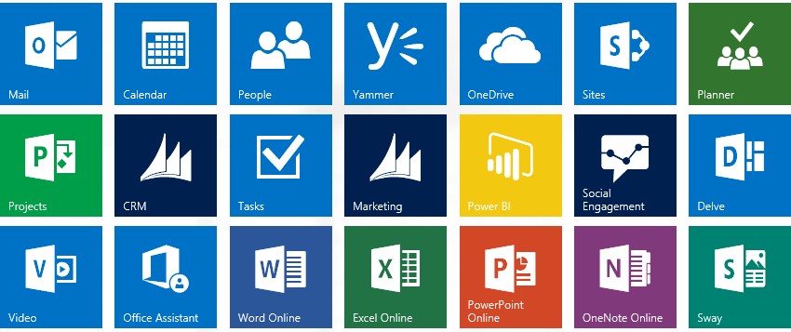


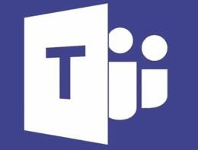
















S k yp e for B u s I n ess
Outlook
SharePoint
Skype Br o a d c asting
Cloud PBX
DLP, Legal Hold
Teams
Office MIX
Office
for 15 Devices
Office Lens
PowerApps
Flow
G I g j a m
Company Apps
Forms
Administration
99.96%
Availability
MyAnalytics
eDiscovery
MFA and Identity
Threat Analytics
ATP, MDM & IRM

Slide 3
Microsoft 365
Authoring | Word, Excel, PowerPoint, OneNote | X
Sites & Content management | SharePoint, OneDrive for Business | X
Mail And Social | Outlook, Exchange, Yammer | X
Meetings & Voice | Skype for Business, Skype Teams Microsoft Phone System (Aka Telephony PBX Integration or Cloud PBX) | X X
Apps & Device Management | Microsoft Intune, Azure Active Directory Premium P1 Windows Store for Business, Microsoft Desktop Optimization Package, VDA | X X
Analytics | Power BI, Delve Analytics, Personal and Org Analytics | X
Security & Compliance | Office 365: Encryption, Data Loss Protection, Rights Management, Compliance Center, Advance Threat Intelligence Windows: Enterprise Data Protection, Windows Hello, Credential Guard, Device Guard, App Locker EMS: Microsoft Advanced Threat Analytics, Azure Information Protection P1 Office 365: Advanced Threat Protection, Advanced Security Management, Customer Lockbox, Advanced eDiscovery Windows: Windows Defender Advanced Threat Protection EMS: Azure Active Directory Premium P2, Microsoft Cloud App Security, Azure Information Protection P2 | X X X X X X

Slide 4


Office365 E5

Slide 5
New value for enterprise customers
Security
Analytics
Voice
Advanced Threat Protection
Power BI Pro
PSTN Conferencing
Advanced Security Management
MyAnalytics
Cloud PBX
Advanced eDiscovery
PSTN Calling*
Customer Lockbox
Built-in Enterprise Protection
Advanced Analytics for All
Complete Cloud
Communication
*PSTN Calling is an add-on to Office 365

Slide 6
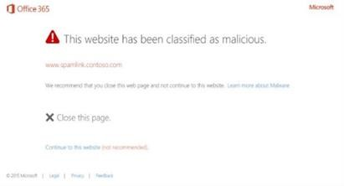
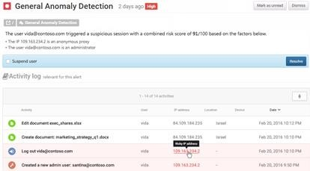
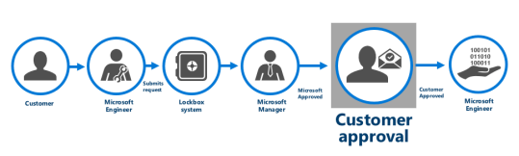
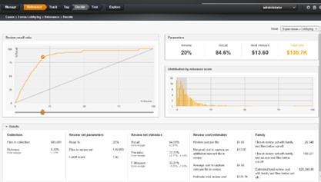
Security
Advanced Threat Protection
Help protect against unknown malware and viruses
Provide real-time, time-of-click protection against malicious URLs
Deliver rich reporting and URL trace capabilities with Click Tracing
Advanced Threat Protection
Advanced Security Management
Identify high-risk and abnormal usage, security incidents, and threats
Gain enhanced visibility and context into Office 365 usage and shadow IT
Reduce the possibility of attacks with granular controls that monitor access
Advanced Security Management
Customer Lockbox
Meet HIPAA & FedRAMP compliance needs with explicit data access procedures
Full access control and oversight provided to customer
Maximize data security and privacy by logging access control activities
Customer Lockbox
Advanced eDiscovery
Focus on what is unique and relevant by training the system to identify emails and documents through predictive coding
Reduce document volume with Near Duplicates and Email Threading
Advanced eDiscovery

Slide 7
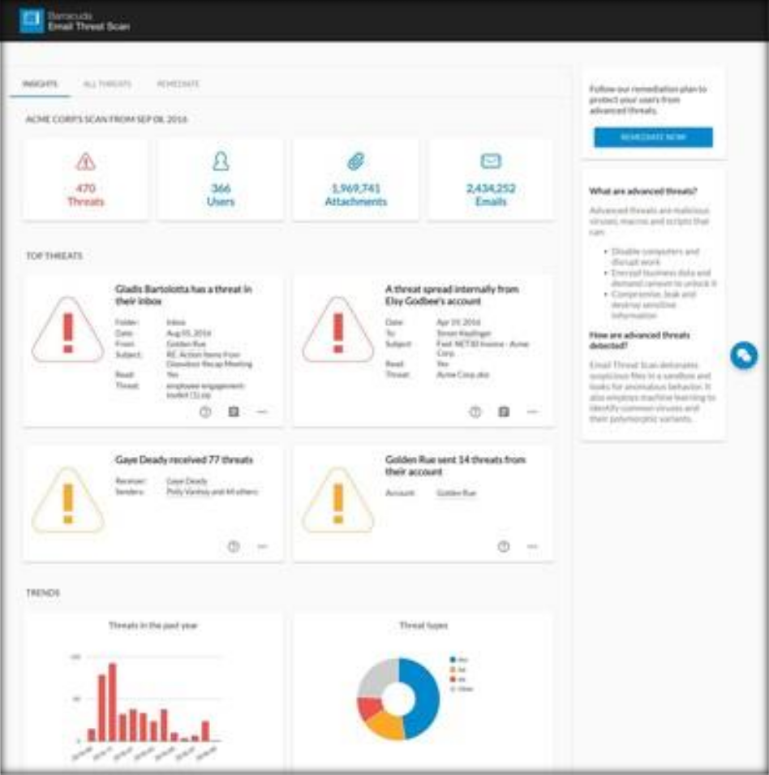
Office 365 Threat Intelligence is a collection of these insights used in analyzing your Office 365 environment to help you find and eliminate threats, proactively.
NEW
You can use the Threat dashboard to see threats that have already been handled, and as a handy tool for reporting out to business decision makers on what Threat Intelligence has already done to secure your business.
If you are investigating or experiencing an attack against your Office 365 environment, use the Threat explorer to analyze threats. Threat explorer shows you the volume of attacks over time, and you can analyze this data by threat families, attacker infrastructure, and more. You can also mark any suspicious email for the Incidents list.
You can also mark suspicious emails you see in Threat explorer for further investigation, and manage response outcomes in a the list of Incidents, a handy way to keep on-track during an attack.

Slide 8
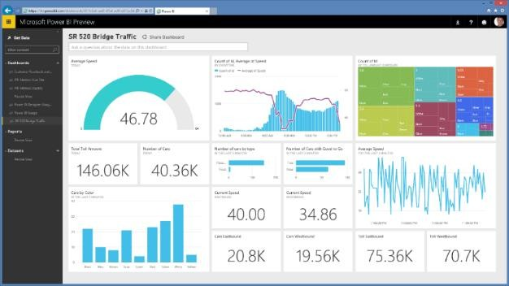
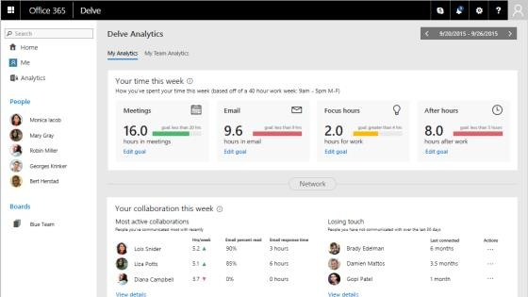
Analytics
Power BI Pro
Gain fast, easy access to the data you need with a simple intuitive experience
Access a live, 360º view of your business through a single dashboard
Discover new insights by exploring your data with rich visualizations
MyAnalytics
Leverage personal analytics to improve individual effectiveness
Use the Outlook add-in to understand email reach and impact
Identify top collaborators and understand collaboration trends
Power BI Pro
MyAnalytics

Slide 9
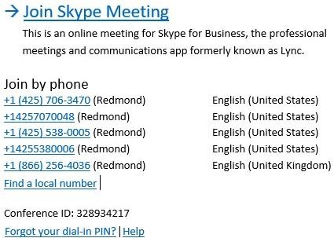
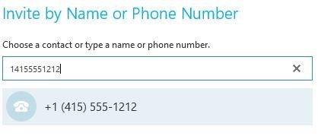
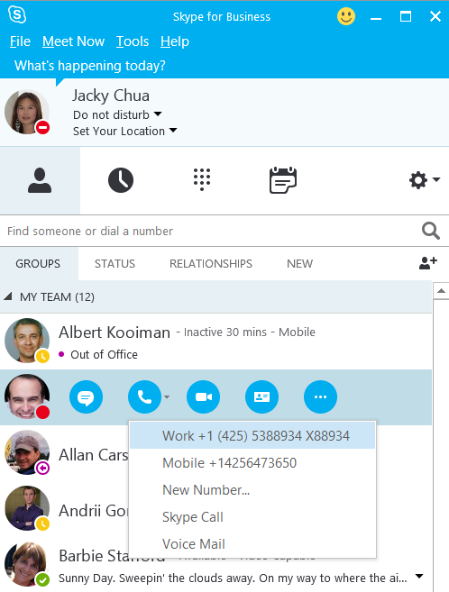
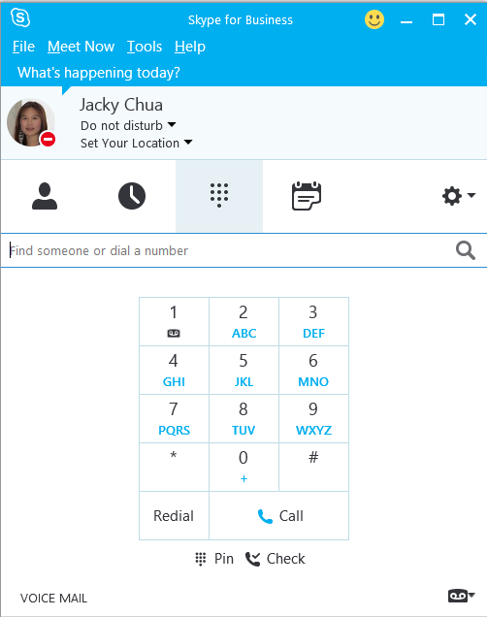
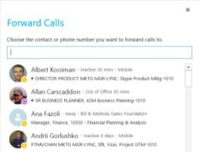
Voice
PSTN Conferencing
Use a tolled dial-in number to join meetings from any device
Dial out to bring participants into the meeting
X
Cloud PBX
Centrally manage users for communications, email, and content from Office 365
Eliminate separate PBX systems and transition to the cloud
PSTN Conferencing
PSTN Calling*
Subscribe to calling plans from Office 365
Use existing phone numbers or get new ones
Cloud PBX
PSTN Calling*
*PSTN Calling is an add-on to Office 365

Slide 10
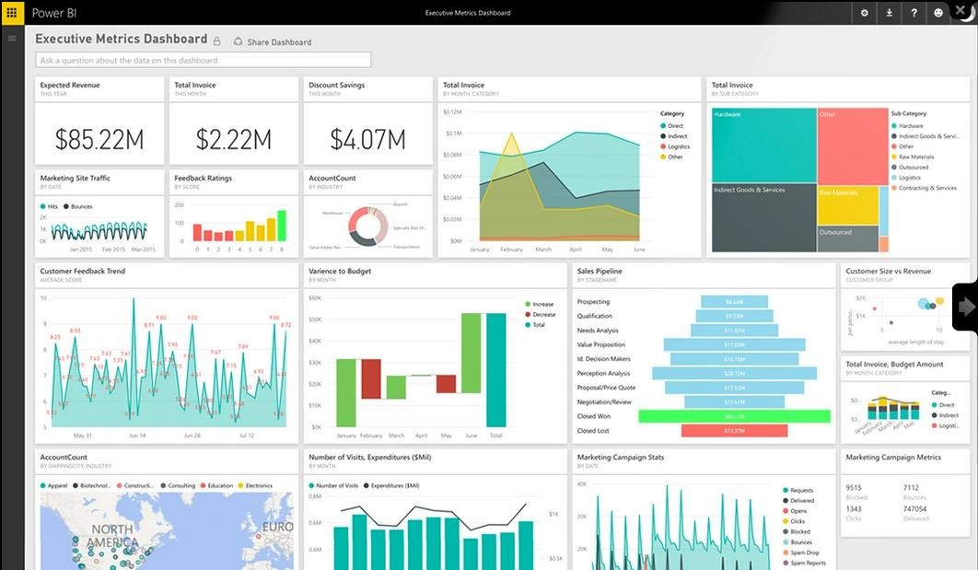

Slide 11
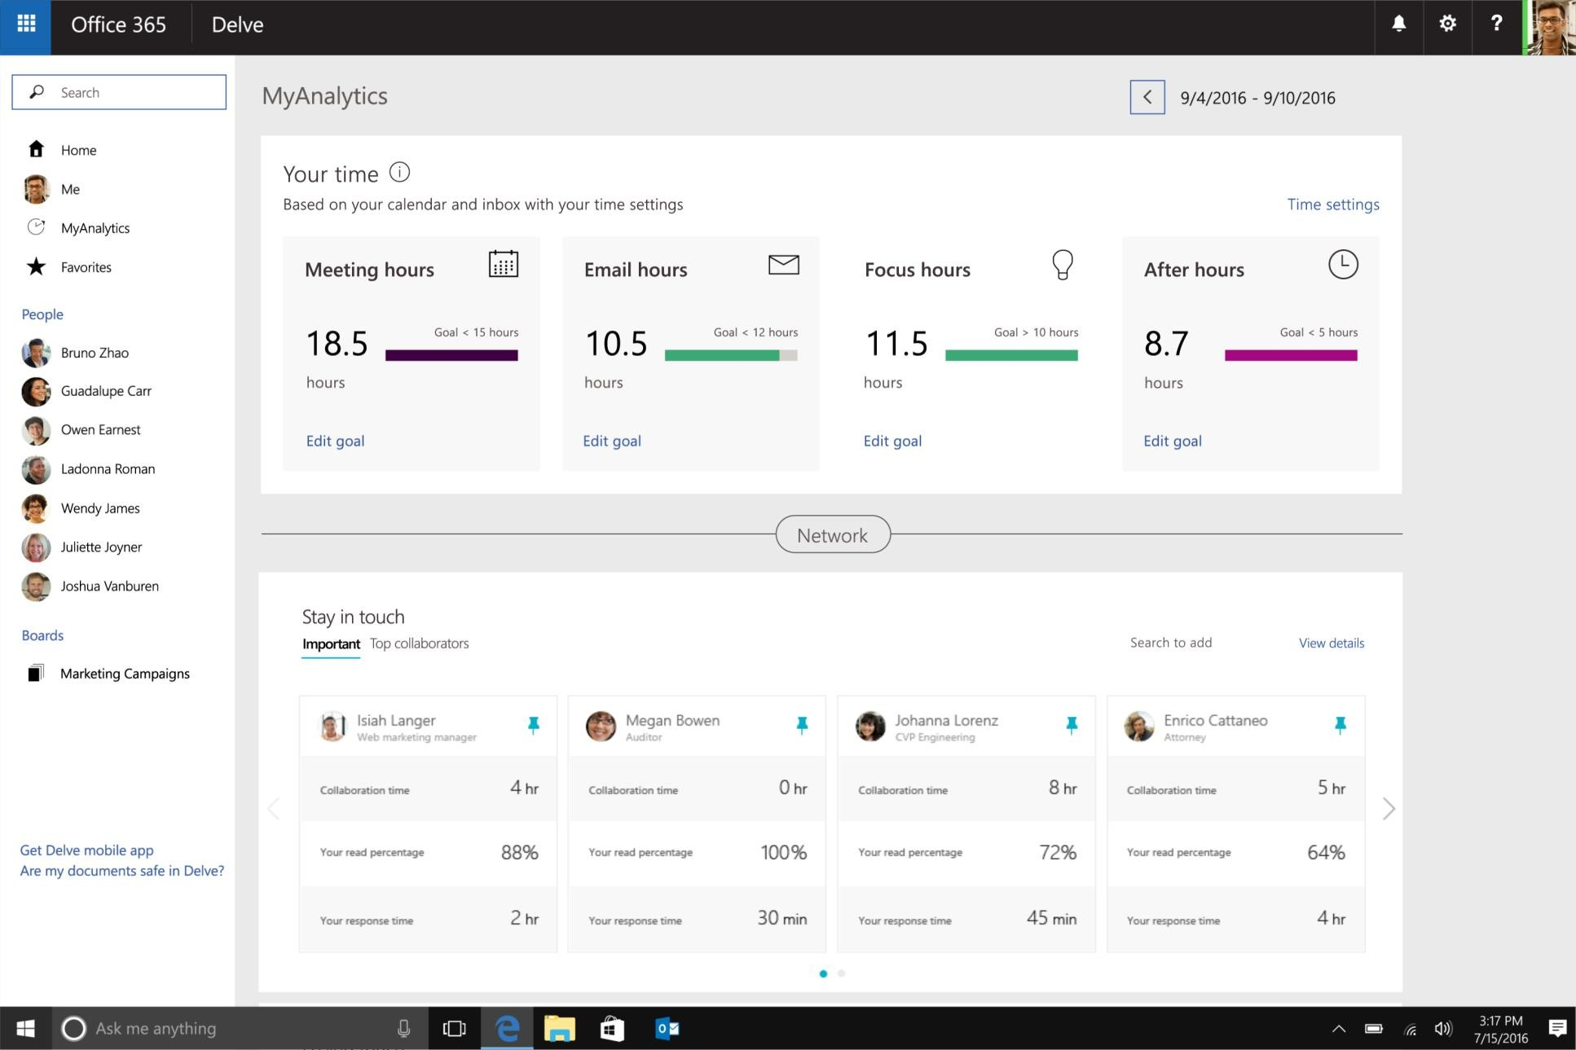
Office 365 MyAnalytics

Slide 12
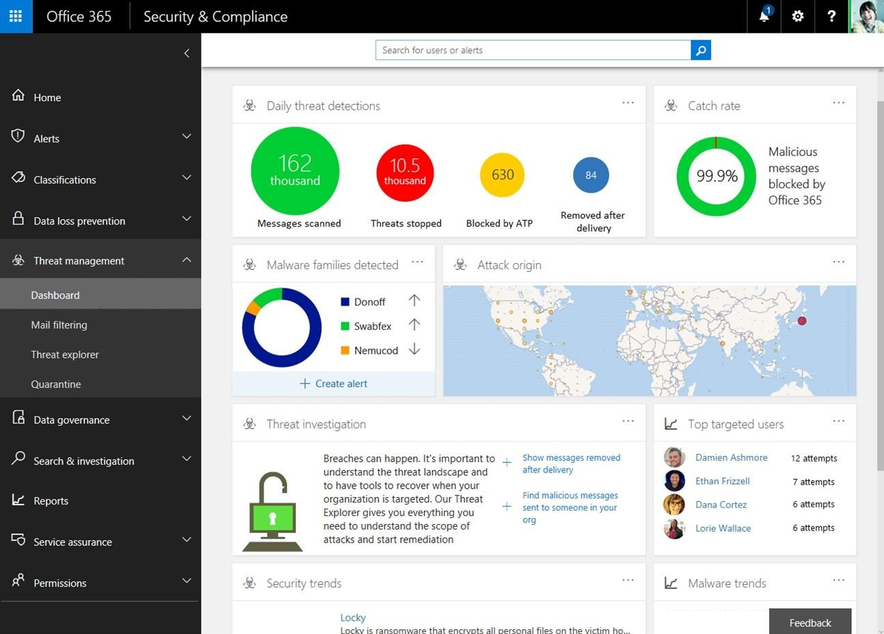
Office 365 Threat Intelligence

Slide 13
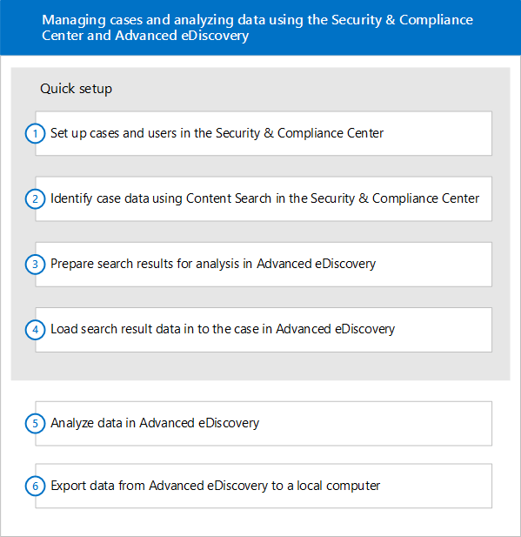
Office 365 Advance eDiscovery

Slide 14
Enterprise + Mobility E5

Slide 15


Data Loss
Prevention
Information Rights Management
Discovery
Mobile Device & Application Management
Secure
collaboration
Mobile Data Loss Prevention
Identity governance
Cloud Data Loss Prevention
User & Entity Behavioral Analytics
Single- sign on
Cloud anomaly detection
Conditional
access
SIEM
Cloud Access Security Broker
Identity & Access Management
Threat
Detection
Cloud
visibility

Slide 16
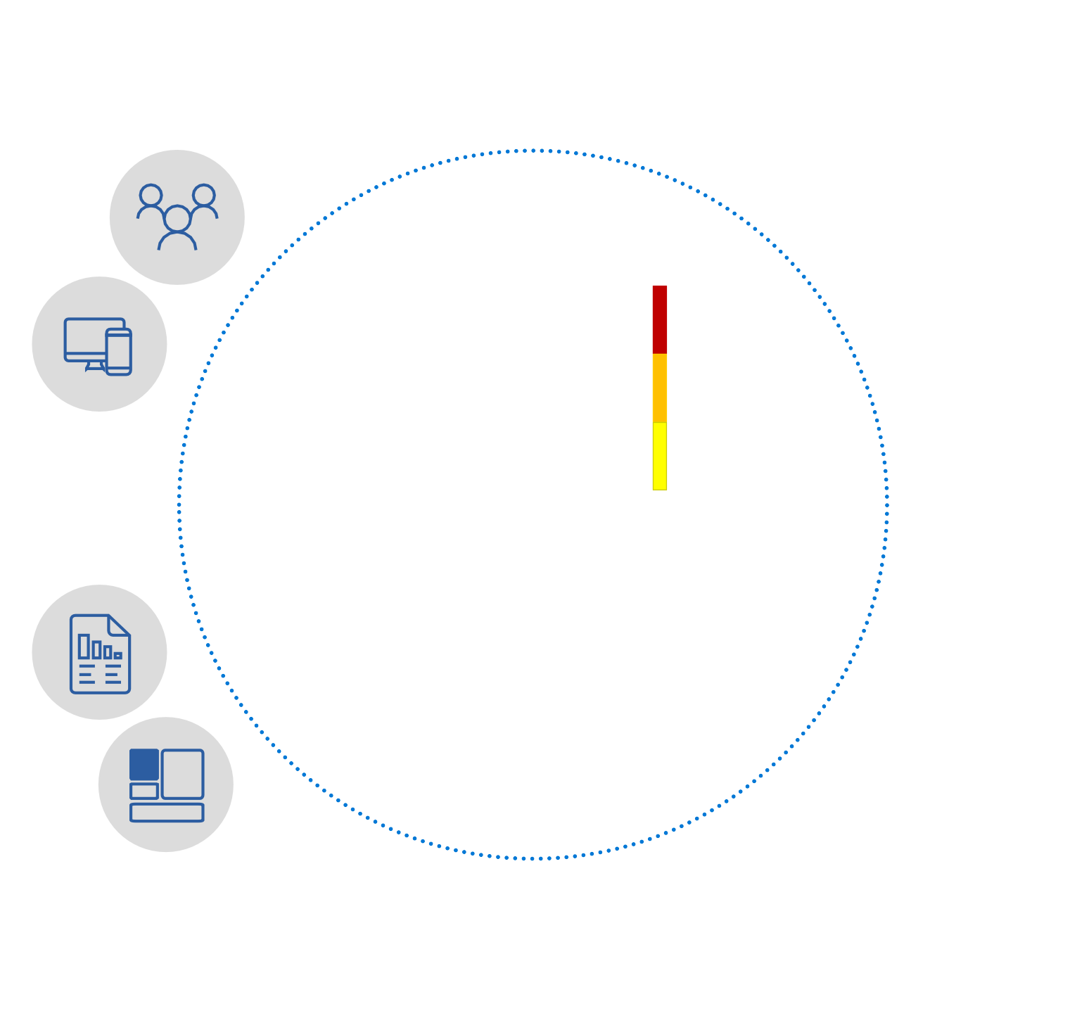







THEN
IF
Allow access
User risk
High
Medium
Low
Privileged user?
Credentials found in public?
Require MFA
Accessing sensitive app? Unmanaged device?
Malware detected?
IP detected in Botnet? Impossible travel?
Anonymous client?
10TB
******
Force password reset
per day
Session risk
High
Medium Low
Deny access
Limit access

Slide 17



Protect at the front door
Protect your data anywhere
Detect & remediate attacks

Slide 18


Protect sensitive data on-premises and in the cloud
Protection
Encrypt your sensitive data and define usage rights or add visual markings when needed.
Monitoring
Use detailed tracking and reporting to see what’s happening with your shared data and maintain control over it.
Classification and labeling
Classify data based on sensitivity and add labels— manually or automatically.

Slide 19



Gain visibility and control over data in cloud apps
Cloud discovery
Discover cloud apps used in your organization, get a risk assessment and alerts on risky usage.
Data visibility
Gain deep visibility into where data travels by investigating all activities, files and accounts for managed apps.
Data control
Monitor and protect personal and sensitive data stored in cloud apps using granular policies.

Slide 20
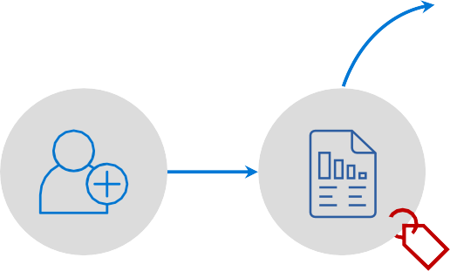




Identifies document tagged
INTERNAL being shared publicly
Uploaded to public share
USER
CLOUD APP SECURITY PORTAL
Move to quarantine
INTERNAL
Azure information protection
Restricted to owner
Role: Finance
Group: Contoso Finance
Office: London, UK
Admin notified about problem.

Slide 21





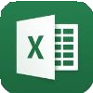





































Data control / separation
Control company data after it has been accessed, and separate it from personal data.
Managed apps
Managed apps
Multi-identity policy
Corporate data
Device security configuration
Enforce device encryption, password/PIN requirements, jailbreak/root detection, etc.
Restrict apps and URLs
Restrict access to specific applications or URL addresses on mobile devices and PCs.
Personal data
Advanced device management
Personal apps
Personal apps
MDM (3rd party or Intune) optional

Slide 22




Intune configures app protection policy
Copy/Paste/SaveAs controls
PIN required
Encrypt storage
USER
User adds business account to OneDrive app
User is prompted
to create a PIN
User edits document stored in OneDrive for Business
User saves
document to…
Allow access
OneDrive for Business

Slide 23
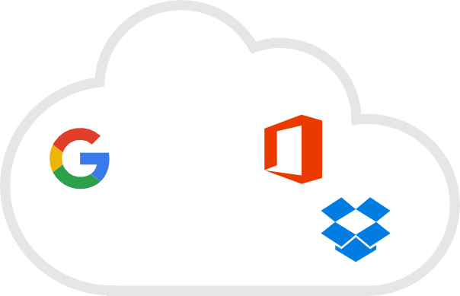




















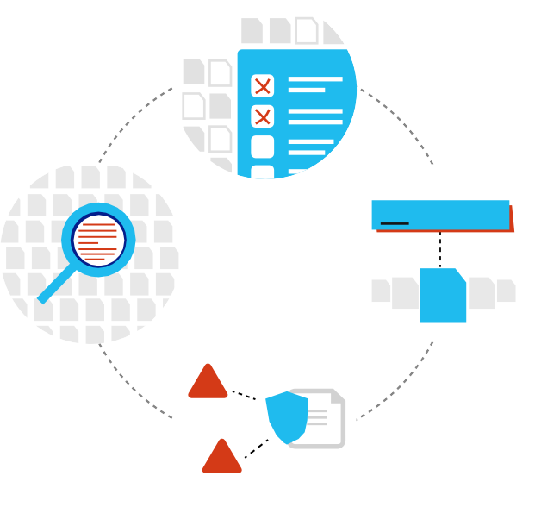






MICROSOFT INTUNE
Make sure your devices are compliant and secure, while protecting data at the application level
MICROSOFT CLOUD APP SECURITY
Gain deep visibility, strong controls and enhanced threat protection for data stored in cloud apps
CONDITIONAL
Classify
ACCESS
AZURE INFORMATION PROTECTION
Classify, label, protect and audit data for persistent security throughout the complete data lifecycle
Location
Access granted to data
Apps
! Risk
Audit
!
Label
Device
!
Protect
AZURE ACTIVE DIRECTORY
Ensure only authorized users are granted access to personal data using risk-based conditional access
!
MICROSOFT ADVANCED THREAT ANALYTICS
Detect breaches before they cause damage by identifying abnormal behavior, known malicious attacks and security issues

Slide 24

Technology
Benefit
E5
Identity and access management | Azure Active Directory Premium P1 | Secure single sign-on to cloud and on-premises app MFA, conditional access, and advanced security reporting | ●
 | Azure Active Directory Premium P2 | Identity and access management with advanced protection for users and privileged identities | ●
Managed mobile productivity | Microsoft Intune | Mobile device and app management to protect corporate apps and data on any device | ●
Information protection | Azure Information Protection P1 | Encryption for all files and storage locations Cloud-based file tracking | ●
 | Azure Information Protection P2 | Intelligent classification and encryption for files shared inside and outside your organization | ●
 | Microsoft Cloud App Security | Enterprise-grade visibility, control, and protection for your cloud applications | ●
Threat protection | Microsoft Advanced Threat Analytics | Protection from advanced targeted attacks leveraging user and entity behavioral analytics | ●

Slide 25


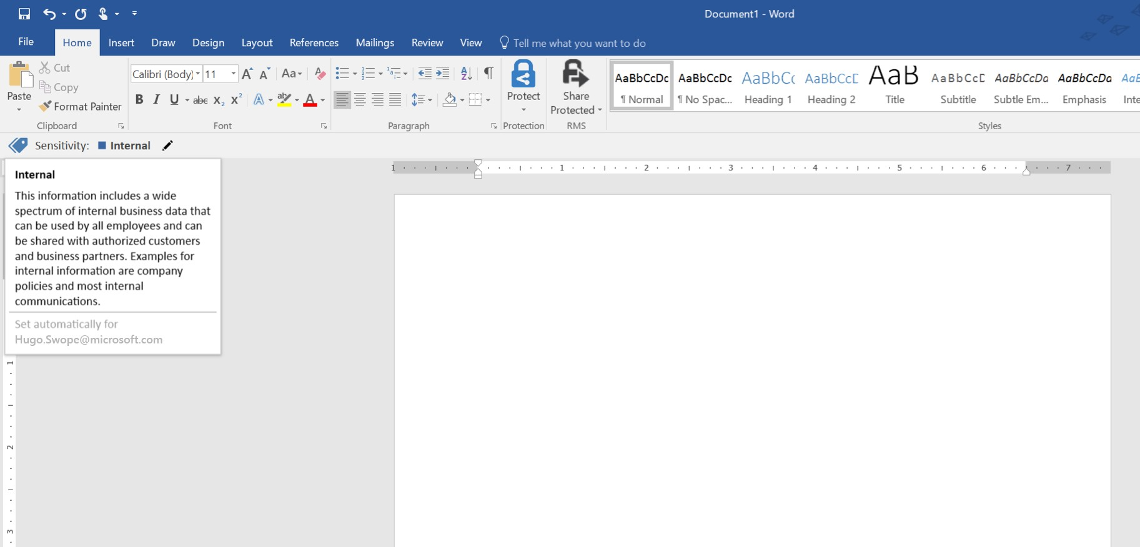

Due Diligence Documentation
Due Diligence
Category Documentation Task Owner Status
Business Plan, Corporate Structure, Financing
Business plan Current five-year business plan
Prior business plan
Corporate organization
Articles of incorporation
Bylaws
Recent changes in corporate structure Parent, subsidiaries, and affiliates Shareholders’ agreements
Minutes from board meetings

Slide 26

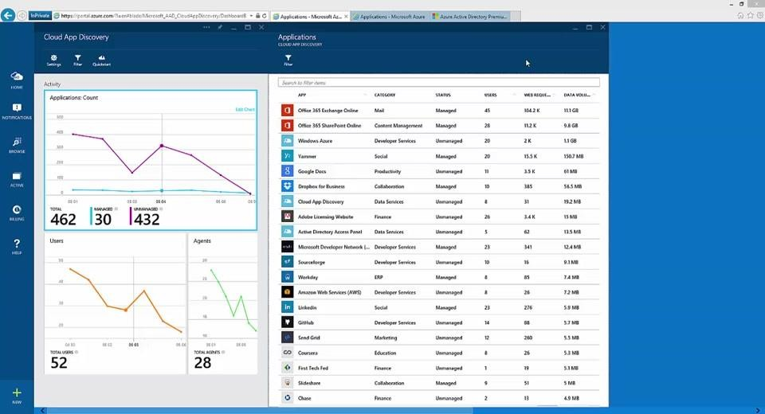

Slide 27
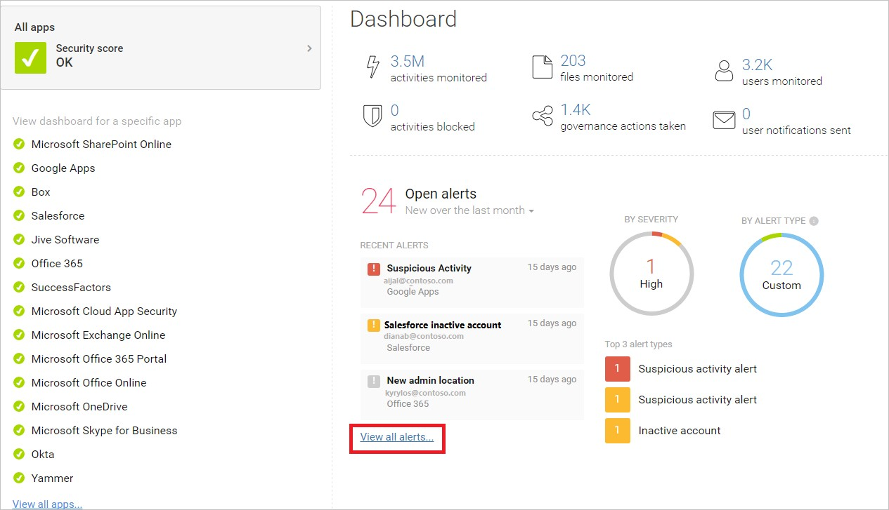

Slide 28

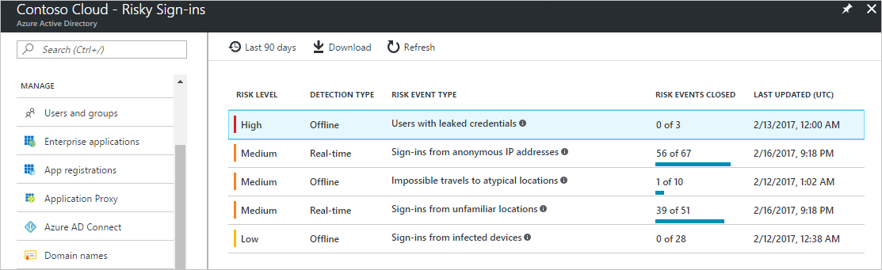

Slide 29
Windows E5

Slide 30


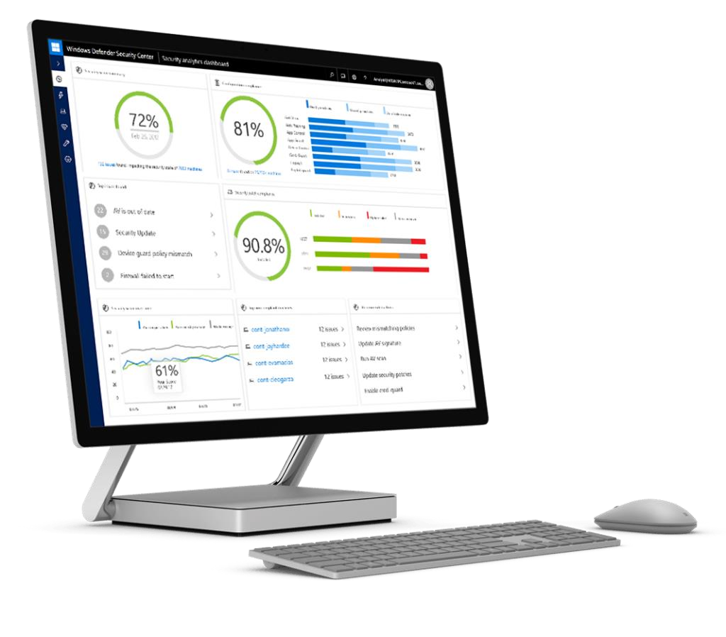

Slide 31



Windows Defender Advanced Threat Protection
Windows Enterprise E-3
Windows Enterprise E-5

Slide 32
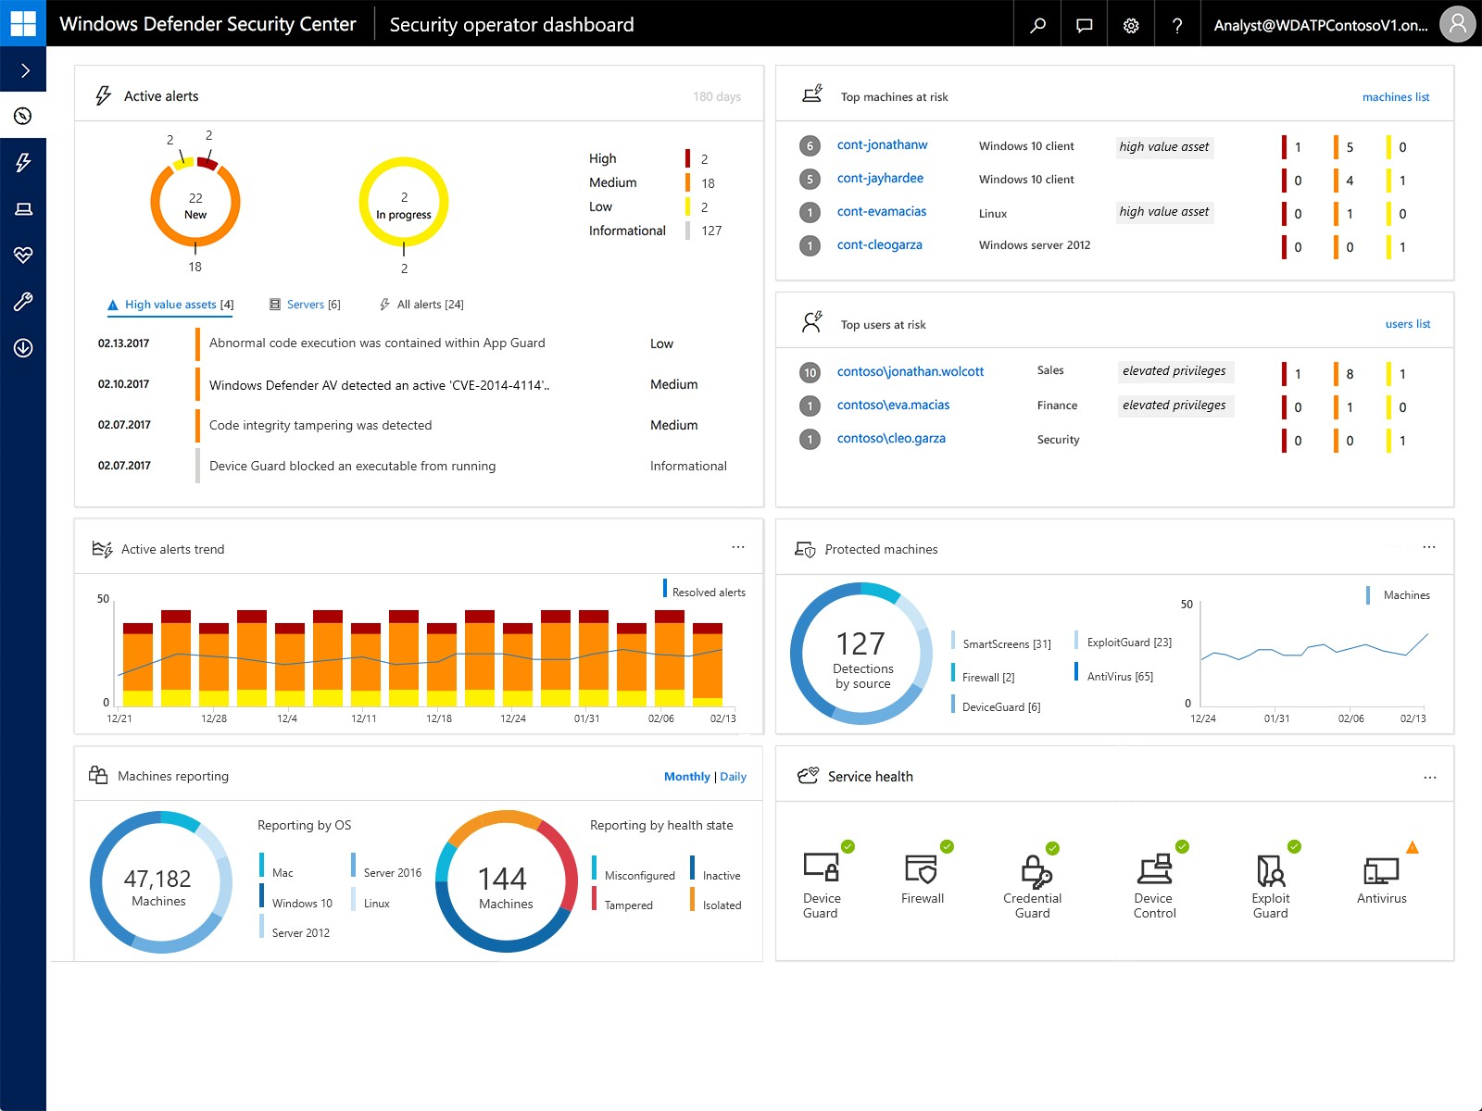

Slide 33
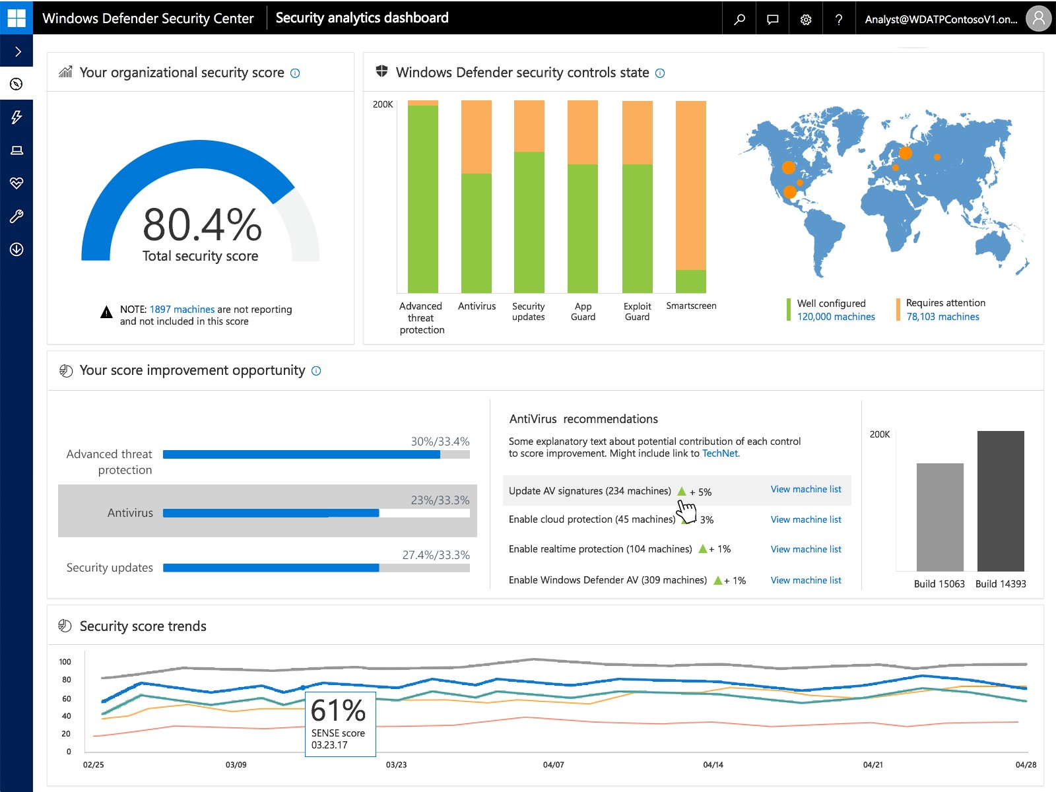

Slide 34
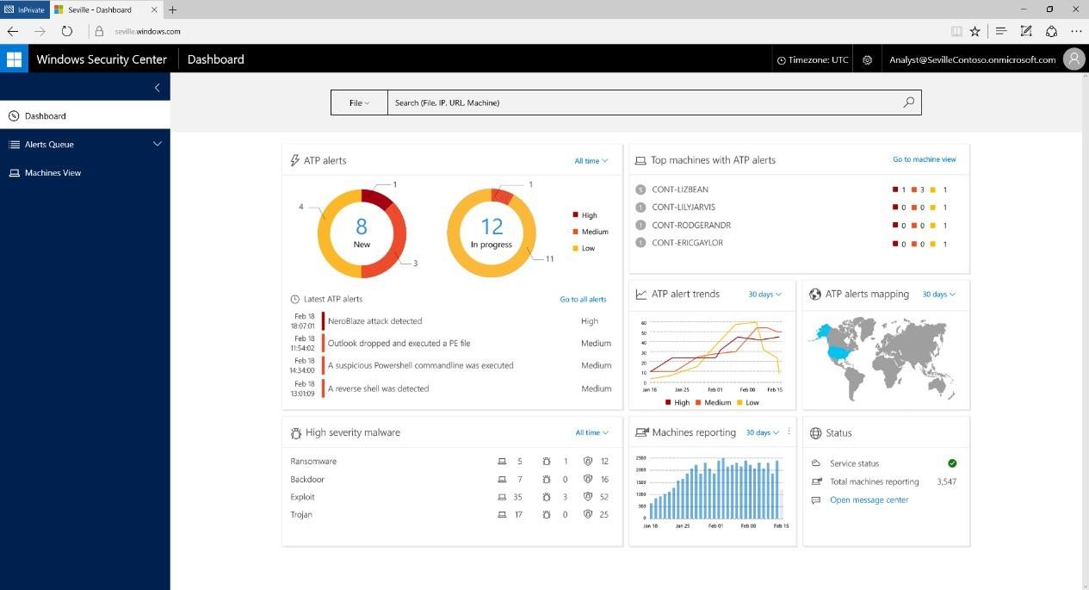

Slide 35
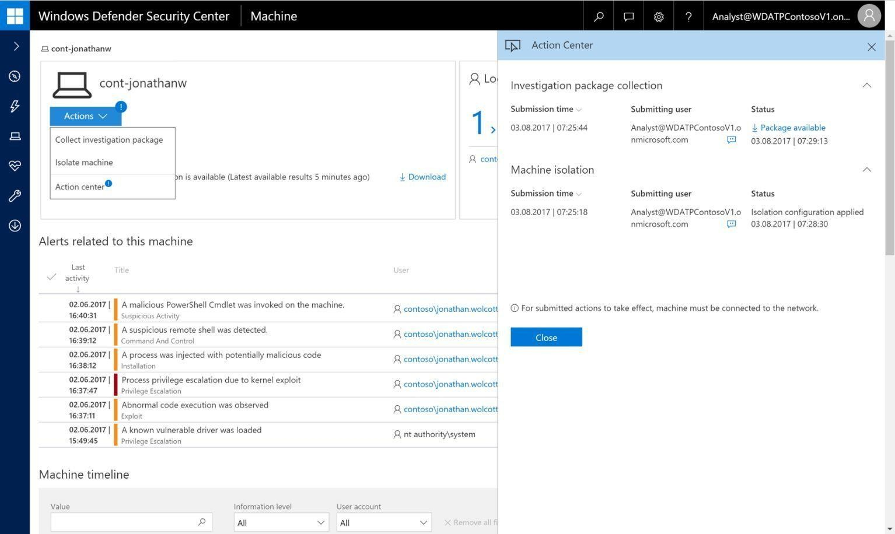

Slide 36



Slide 37
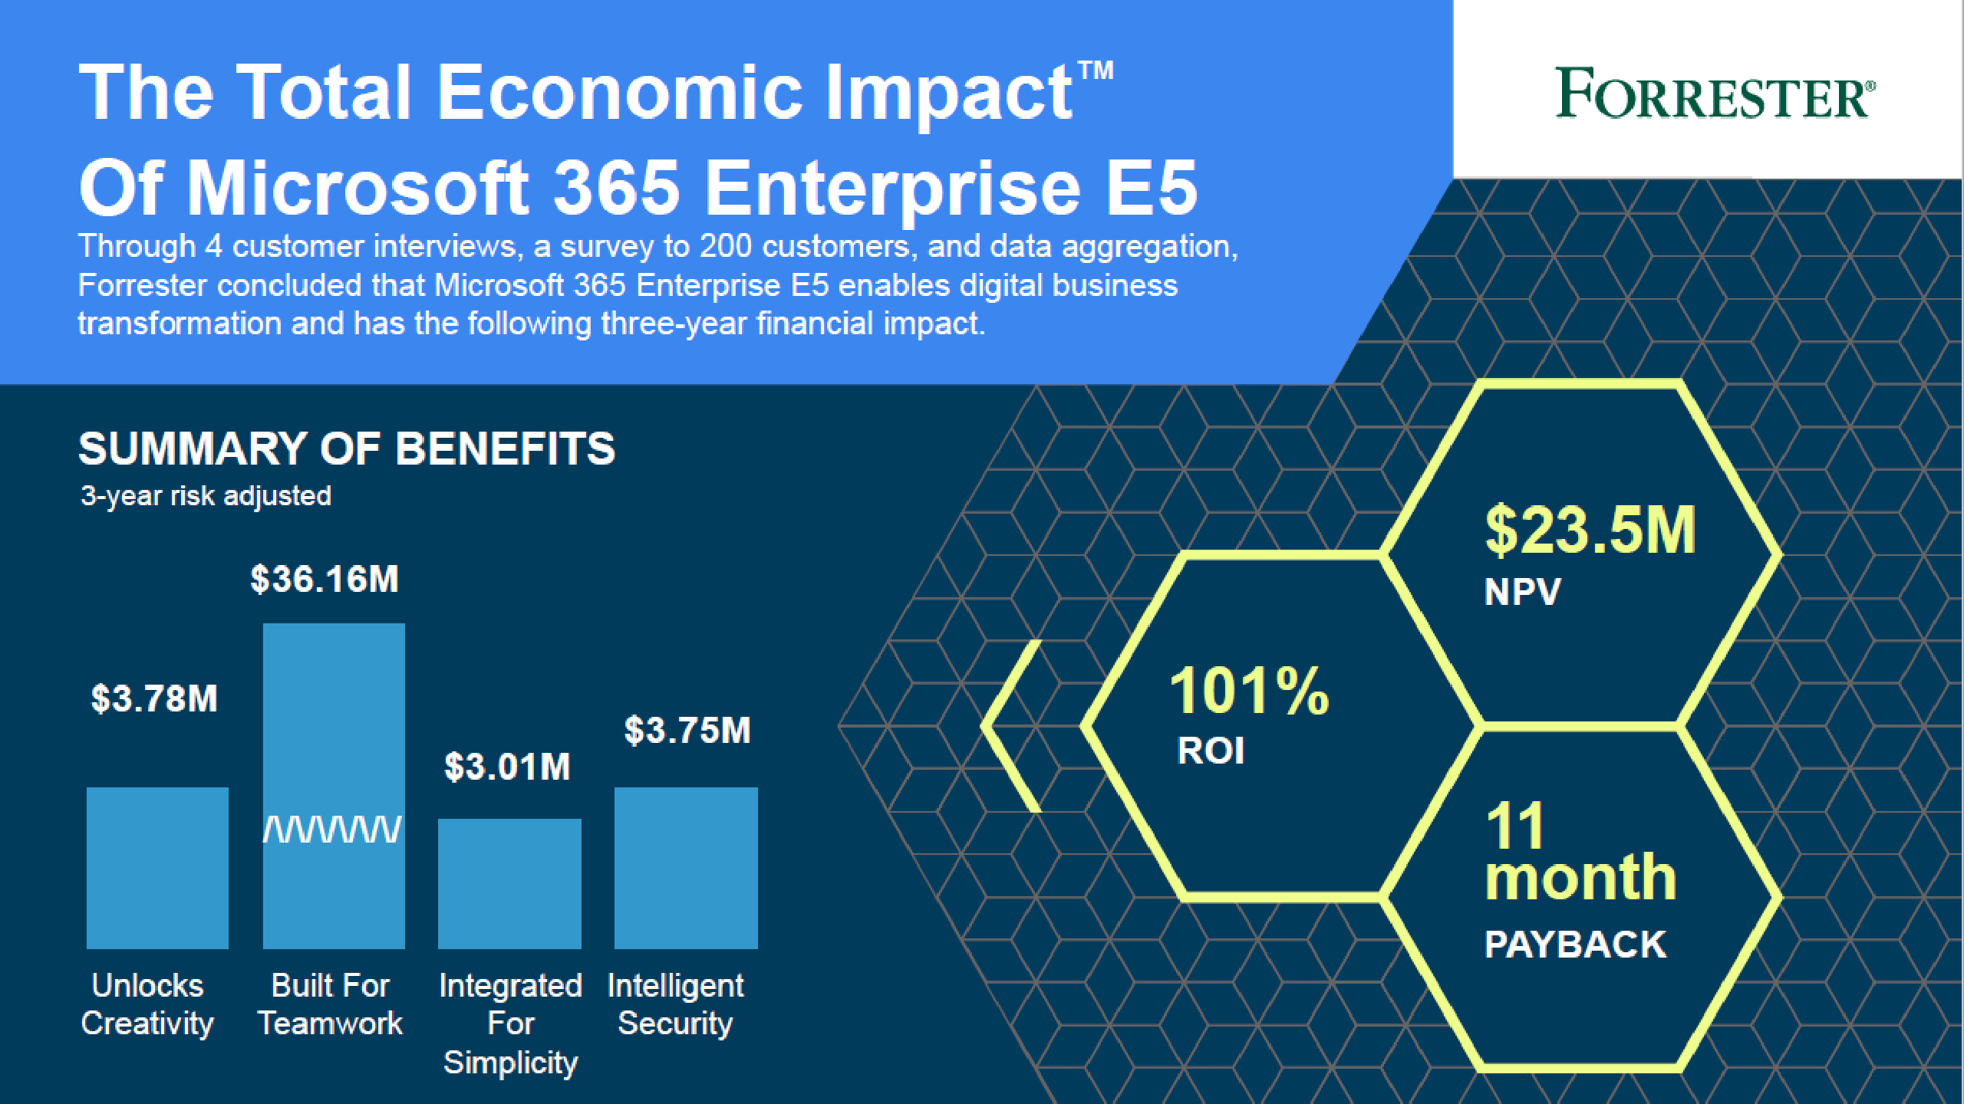

Slide 38
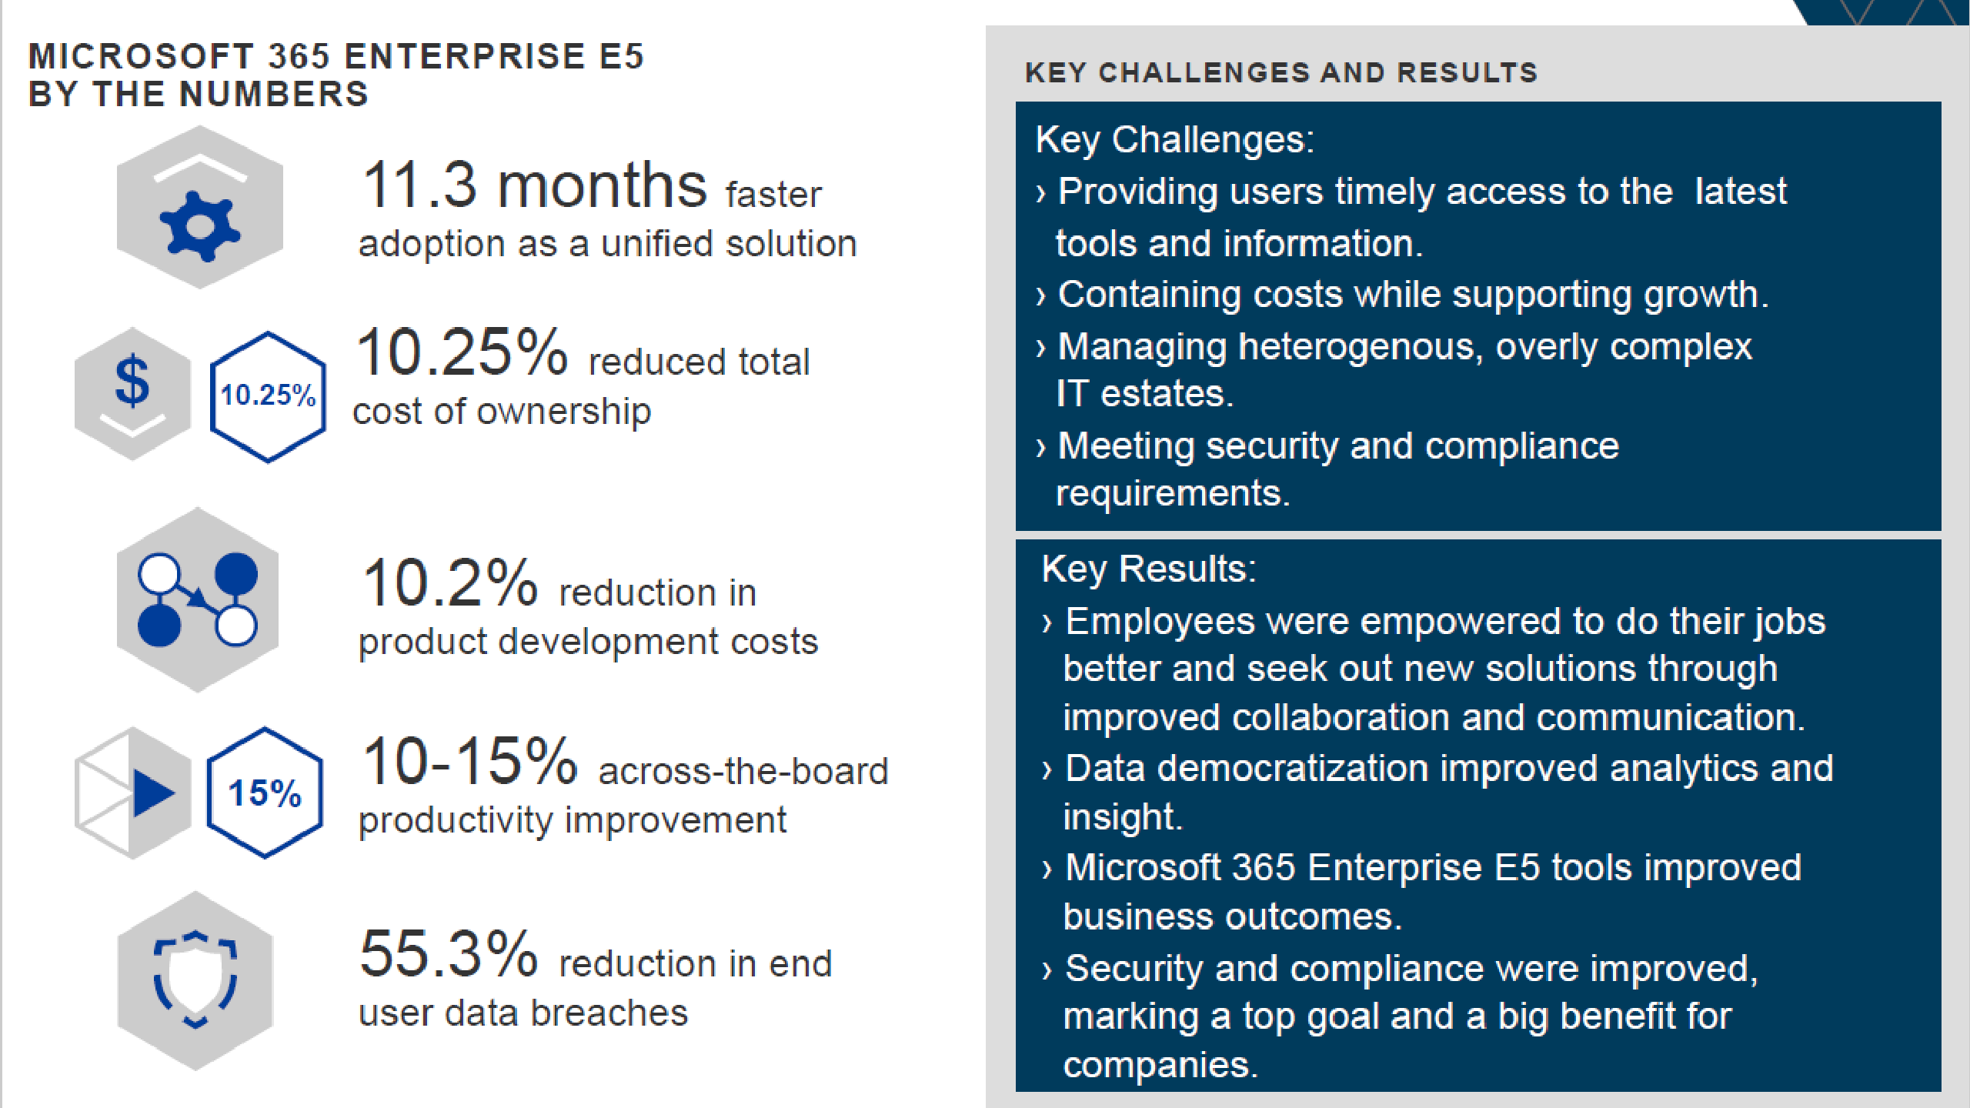

Slide 39

The cost saving of investing in Microsoft 365 E5 instead of Individual Components on top of M365 E3
ATP Office365 $1.8
Threat Intelligence $7.1
Cloud App Security $2.7
ATP Windows $4.6
Power BI $8.8
Azure ATP $2.0
Office365 Cloud App Security $2.7
Microsoft Phone System $7.04
Information Protection P2 $2.7
Active Directory Premium P2 $2.7
What Do You Need: $16.2 Per User Per Month
Additional Products: $25.94
Microsoft 365 E5 Step Up: $22.5

Slide 40
Adoption and Deployment

Slide 41

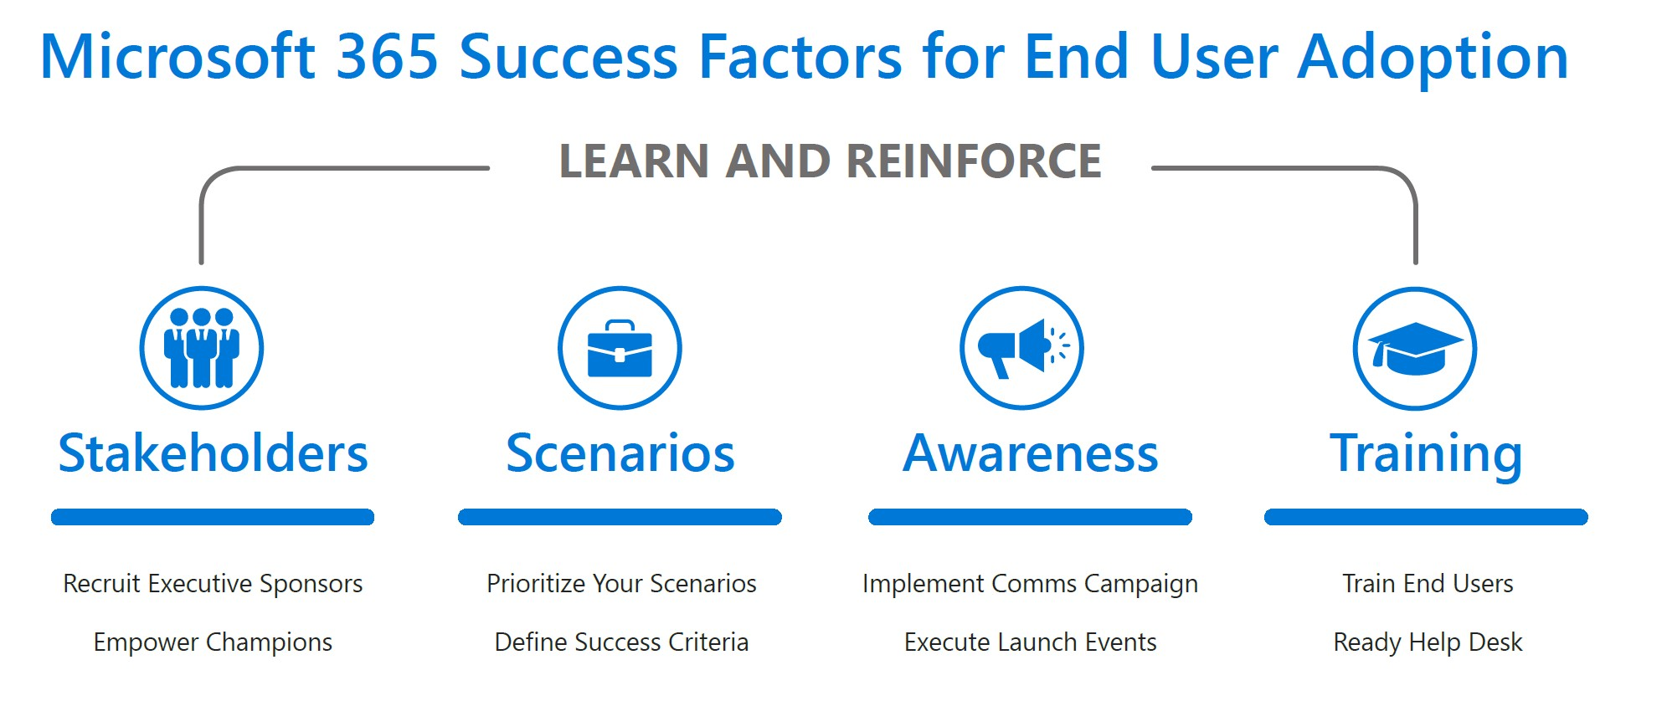

Slide 42
The Case for Microsoft 365 E5

Slide 43

Multi-factor authentication
Data encryption
User accounts
Device log-ins
Malware
Unauthorized data access
Attacks
INTELLIGENCE
User log-ins
Phishing
Denial of service
Spam
System updates
Enterprise security

Slide 44


450B user authentications each month
1B Windows devices updated
400B emails analyzed for spam and malware
Notes:
Be clear about how to position and pitch Intelligent Security Graph

Slide 45
MICROSOFT THREAT PROTECTION
INTELLIGENT & INTEGRATED
OUR UNIQUE APPROACH
Active Directory Premium
Advanced Threat Analytics
Identity
EMS E5
Office365 E5
Windows E5
PLATFORM
Windows 10 Intune
Device
MICROSOFT ADVANCED
THREAT ANALYTICS
EXCHANGE ONLINE PROTECTION
WINDOWS DEFENDER
ADVANCED THREAT PROTECTION
AZURE ADVANCED THREAT PROTECTION
OFFICE 365
ADVANCED THREAT PROTECTION
Cloud App Security
Intune
Apps & infrastructure
AZURE ACTIVE DIRECTORY IDENTITY PROTECTION
OFFICE 365 THREAT INTELLIGENCE
AZURE INFORMATION PROTECTION
OFFICE365 CLOUD APP SECURITY
Information Protection
Data
EMS CLOUD APP SECURITY
Notes:
By leveraging the Microsoft Intelligent Security Graph, Microsoft’s threat protection services provide intelligence and integration across your organization’s entire threat protection stack to help address your biggest security concerns:
Gaining the ability to protect your business from advanced cyber attacks.
Having the capability to help detect suspicious behavior within the organization.
Developing processes and having the tools to quickly respond to threats which enable damage control and limit the effects from an attack.
With the ability to protect, detect, and respond, to the growing and evolving cyber threat landscape, your organization can immediately enjoy greater security and focus on tasks which are fundamental to your business rather than worry about being impacted by a cyber attack.

Slide 46
Microsoft 365 Enterprise Plan Overview
 |  | M365 F1 | M365 E3 | M365 E5
Office Client Applications | Word, Excel, PowerPoint |  | ● | ●
 | OneNote, Access |  | ● | ●
Office Mobile Apps | Word Mobile, Excel Mobile, PowerPoint Mobile, OneNote Mobile, Outlook Mobile | ² | ● | ●
Email & Calendar | Outlook, Exchange | ³ | ● | ●
Chat-based Workspace | Microsoft Teams | ● | ● | ●
Voice, Video & Meetings | Skype for Business | ⁴ | ● | ●
 | Audio Conferencing, Phone System |  |  | ●
Social & Internet | SharePoint & Yammer | ⁵ | ● | ●
Threat Protection | Microsoft Advanced Threat Analytics, Windows Defender Antivirus, Device Guard⁶ | ● | ● | ●
 | Windows Defender Advanced Threat Protection, Office 365 Advanced Threat Protection, Azure Advanced Threat Protection, Office 365 Threat Intelligence |  |  | ●
Identity & Access Management | Azure Active Directory Premium Plan 1, Windows Hello, Credential Guard and Direct access⁶ | ● | ● | ●
 | Azure Active Directory Premium Plan 2 |  |  | ●
Device & App Management | Microsoft Intune | ● | ● | ●
 | Windows AutoPilot, Fine Tuned User Experience, and Windows Analytics Device Health | ● | ● | ●
Information Protection | Windows Information Protection & BitLocker | ● | ● | ●
 | Azure Information Protection Plan 1 | ● | ● | ●
 | Azure Information Protection Plan 2, Microsoft Cloud App Security, O365 Cloud App Security |  |  | ●
 | Office 365 Data Loss Prevention |  | ● | ●
Advanced Compliance | Advanced eDiscovery, Customer Lockbox, Advanced Data Governance, Customer Key, Privileged access management in Office 365 |  |  | ●
Advanced Analytics | Delve |  | ● | ●
 | Power BI Pro, MyAnalytics |  |  | ●
¹Productivity Server Rights – SharePoint, Exchange and Skype for Business productivity server rights for M365 E3 & E5 customers (Hybrid Rights unavailable in CSP Channel).
²Limited to devices with integrated screens 10.1” diagonally or less.
³2GB Inbox, No Voicemail.
⁴Meetings are join only, 1:1 audio/video calls are supported, No Desktop or App Sharing
⁵Cannot be Site Administrators, No Site Mailbox, No Personal Site, Cannot Create Form
⁶Not available on Windows 10 Enterprise E3 in S mode

Slide 47
Questions?

Slide 48
Thank You ☺

